Slide 1
FAST RELIABLE FILE TRANSFER
By : Nuo Xu
Pooja Ravindra
Vishwaksen Jalagam

Slide 2
CONTENTS
INTRODUCTION
NETWORK TOPOLOGY
METHODOLOGY
RESULTS AND DISCUSSIONS
CONCLUSION

Slide 3
INTRODUCTION
TCP is widely acclaimed for its reliability and robustness
There are scenarios where TCP may not deliver the expected level of reliability

Slide 4
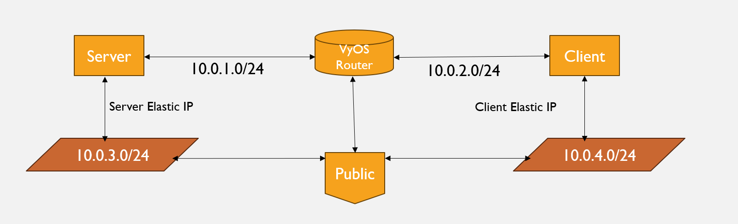
NETWORK TOPOLOGY ON AWS

Slide 5
WORKING PRINCIPLE
SERVER
CLIENT
Requests the file
Writing the received contents (portion of the file it will receive and offset to read the file from ) into the file
FILE
Received the file successfully !
Thread 1
Writing the received contents into the file
FILE
Thread 2
.
Thread 3
Writing the received contents into the file

Slide 6
PSEUDOCODE FOR CLIENT
1. Initialize client parameters:
- Parse command-line arguments (hostname, port, thread_count).
- Create a server address structure (sockaddr_in) with the server's IP address and port.
2. Create a local file for saving the downloaded data:
- Open or create a local file for writing (e.g., "result.txt") using open() or similar functions.
- Handle any errors in file creation.
3. Create client sockets and threads:
- Create an array or vector of client socket descriptors (s) and an array or vector of threads (ts).
4. Loop to create client threads:
- In a loop, for each thread (i = 0 to thread_count-1):
- Create a socket (s[i]) using socket().
- Connect to the server using connect() with the server address structure.
- In the thread, call a thread function (thread_func) with parameters (i, s[i], server, fd).
5. Thread function (thread_func):
- This function runs in each client thread.
- Send metadata about the file to the server (e.g., read size and offset).
- Receive data from the server in a loop and write it to the local file.
- Handle errors during data transfer.

Slide 7
6. Wait for all client threads to finish:
- Use thread.join() or a similar mechanism to wait for all threads to complete.
7. Close client sockets and the local file:
- Close all client sockets (s[i]) in a loop.
- Close the local file (fd).
8. Cleanup and exit:
- Print a message indicating successful completion.
- Exit the client program.
9. Main program:
- Parse command-line arguments for hostname, port, and thread_count.
- Create client threads to connect to the server and download the file.
- Wait for all threads to finish and perform cleanup.
10. Handle error cases and exceptions as needed.

Slide 8
PSEUDOCODE FOR SERVER
1. Initialize server socket:
- Create a socket using socket() function.
- Set socket options if needed.
- Bind the socket to a specific IP address and port using bind().
- Listen for incoming connections using listen().
2. Accept client connections in a loop:
- Use accept() to accept incoming client connections.
- Create a new thread or process to handle each client connection (optional).
3. Client Handling:
- In the client handling thread/process:
- Read data from the client using recv() or read().
- Process the received data as needed (e.g., parse requests).
- Generate a response or perform server logic.
- Send the response back to the client using send() or write().
4. Cleanup:
- Close the client socket when done.
- Optionally, perform any necessary cleanup operations.
5. Close the server socket when the server is done.

Slide 9
TEST CASES
The Delay (RTT) of 10ms with the Loss rate of 1% (bi-directional) set at router and link speed set to 100Mbits/sec for server, client and router. (case - 1)
The Delay (RTT) of 200ms with the Loss rate of 20% (bi-directional) set at router and link speed set to 100Mbits/sec for server, client and router. (case - 2)
Set link speed to 80 Mbits/sec and delay (RTT) to 200ms on with no drop at router and server, client link speed set to 100 Mbits/sec. (case - 3)
Note : The results we achieved were different on different runs We faced bottleneck issues because of memory constraints in t2.micro storage in EC2 instances as compared to the test we carried out in our local set up with the same topology

Slide 10
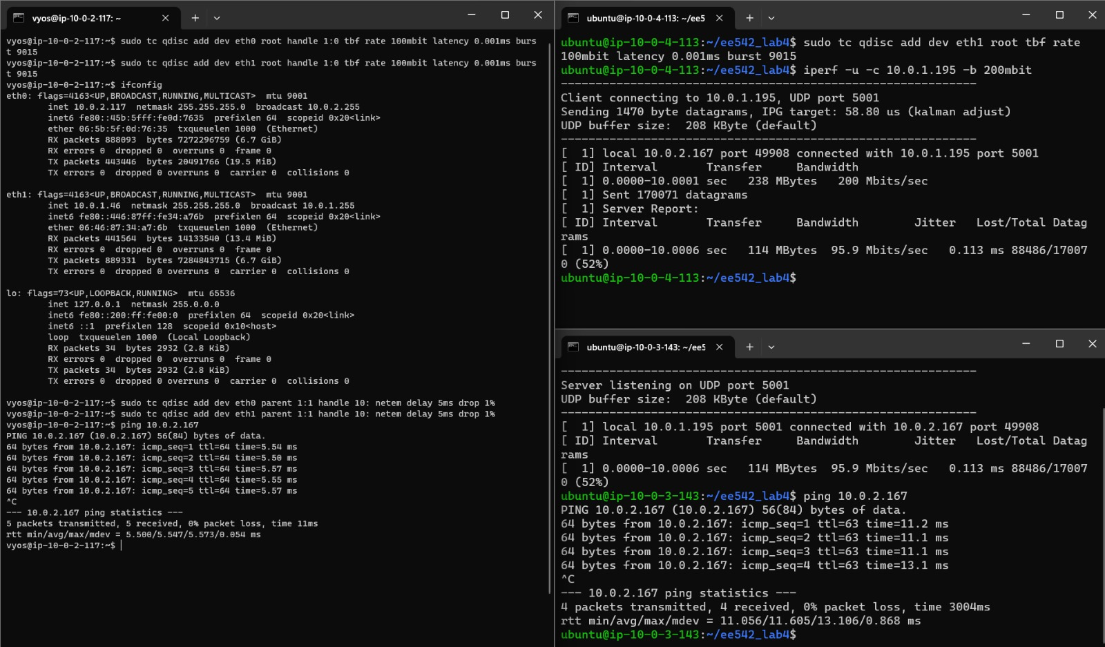
Case 1: For RTT of 10ms, drop of 1%, MTU 9001

Slide 11
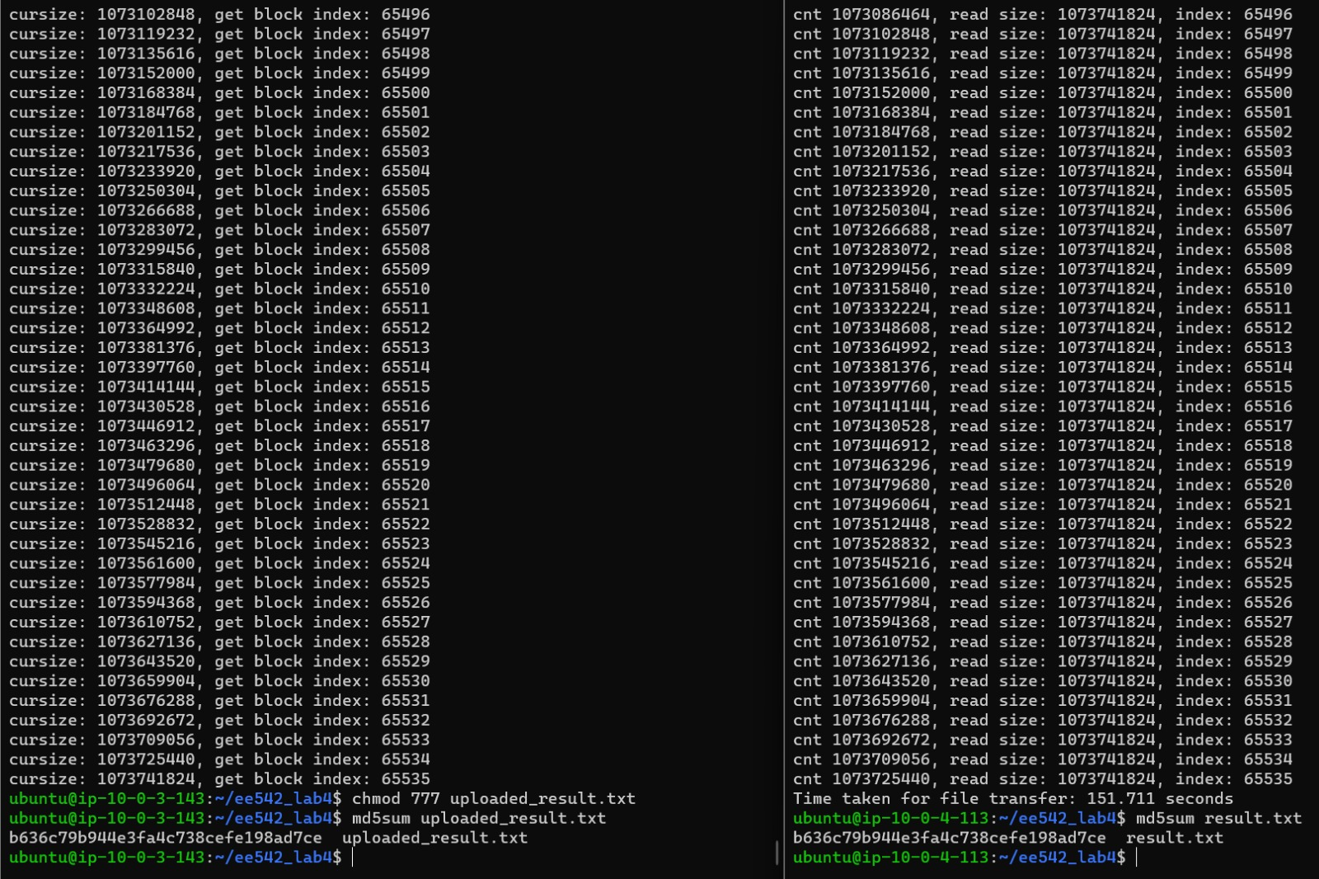
sudo tc qdisc add dev eth0 root tbf rate 100mbit latency 0.001ms burst 9015 sudo tc qdisc add dev eth0 root handle 1:0 tbf rate 100mbit latency 0.001ms burst 9015 sudo tc qdisc add dev eth1 root handle 1:0 tbf rate 100mbit latency 0.001ms burst 9015

Slide 12
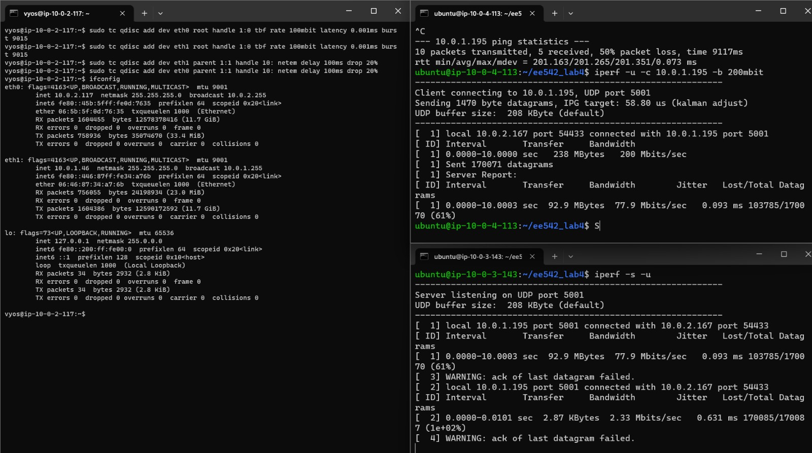
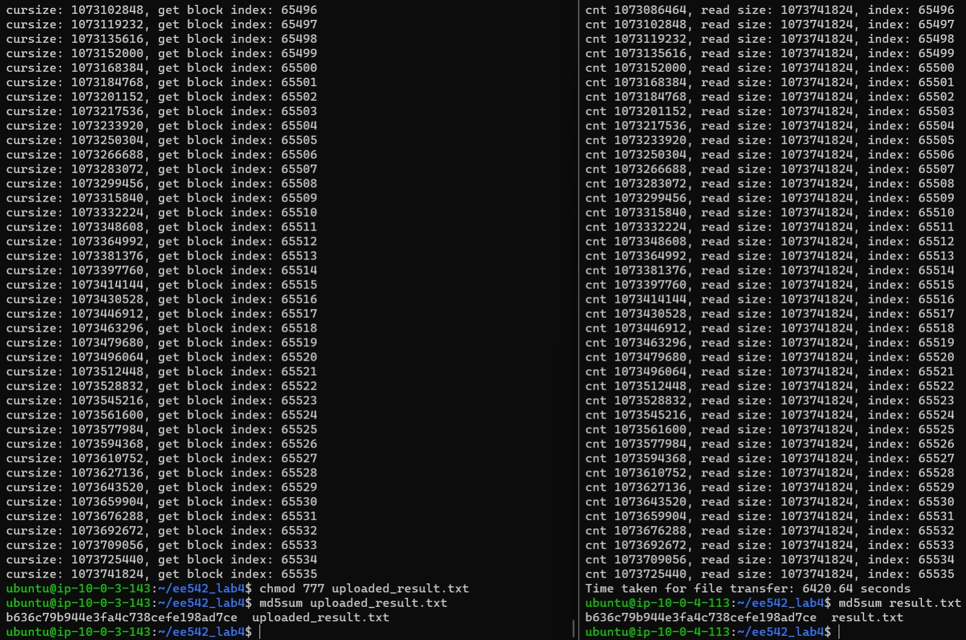
Case 2: For RTT of 200ms, drop of 20%, MTU 9001

Slide 13
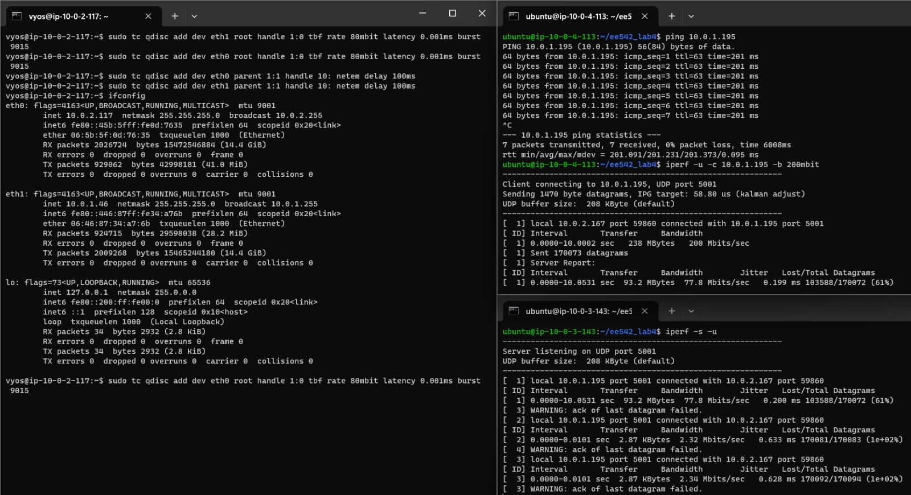
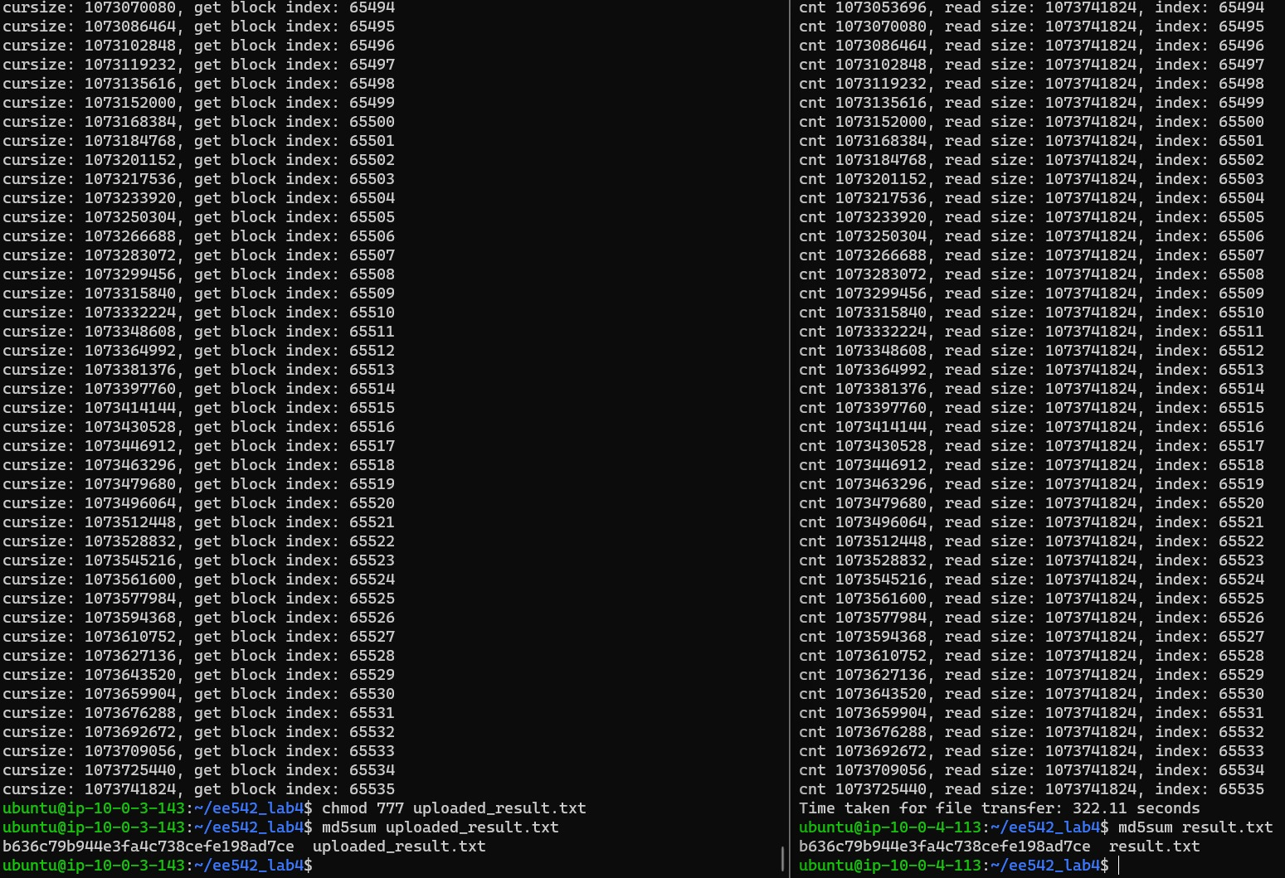
Case 3: For RTT of 200ms, drop of 0%, MTU 9001

Slide 14
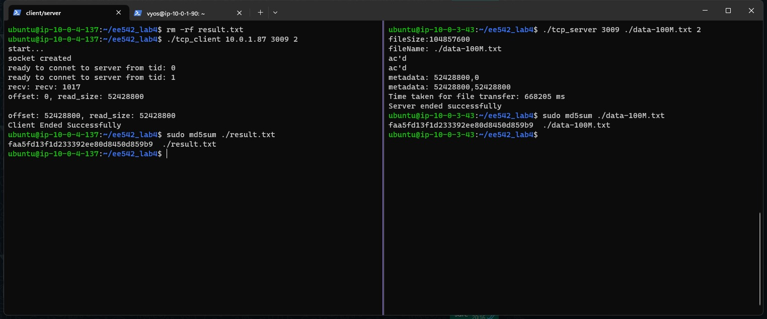
DEMO CASE : RTT 200ms, Loss 1%
File size 100Mbit

Slide 15
RESULTS
CASE NUMBER | Throughput for MTU=1500 | Throughput for MTU=9001
1 | 24.12 Mbps | 56.62 Mbps
2 | 641 Kbps | 1.337 Mbps
3 | 24.22 Mbps | 26.69 Mbps

Slide 16
ISSUES ENCOUNTERED
Issue 1: UDP socket overload on AWS t2.micro, causing a high sending rate and overwhelming the server
Issue 2: Suboptimal performance in case 2 with increased delay and packet loss, especially with an MTU of 1500
Adaptation: Transitioned retransmission logic from UDP to TCP due to frequent ACK packet loss during case 2
Scaling: Upgraded AWS instance to t2.medium to leverage multithreading capabilities for improved performance
Buffer Adjustment: Modified TCP send and receive buffer sizes to handle 200ms delay without overflowing
Future Improvement: Recognized potential enhancement with separate threads for client data reception and server data transmission, aiming for even better results

Slide 17
Observation
We can see that for case 2 and 3, the UDP throughput is similar but the TCP throughput differs
This is because TCP reacts conservatively to latency and packet loss, reducing its sending rate which leads to lower throughput
UDP is a best effort protocol and does not have a congestion control mechanism
UDP prioritizes throughput over reliability and hence is unreliable

Slide 18
THANK YOU

